Slide 1
Break!
By: Iman Khani Jazani
Senior Data Scientist, Community builder | Adin
AI and Data Specialist, Business Developer | AiHum
Adjunct Professor | Sharif University of Technology

Slide 2
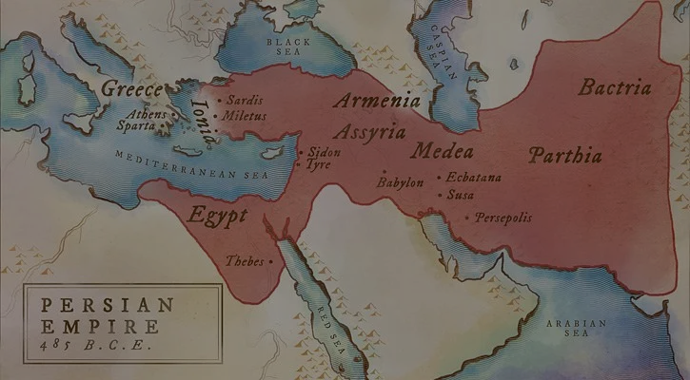
امیدوارم امسال سالی باشه که تووش یه عالمه موفقیت براتون رقم بخوره و کلی دلتون شاد باشه و من هم از شادیتون لذت ببرم و امیدوارم امسال باعث خوشحالی دل خودتون و بقیه باشین...
دوستتون دارم، ایمان
14/1/1402

Slide 3
Today
Review of previous slides
Again, Talk about final project
Question and answer!

Slide 4
Together
Send your feedback about the class whenever you want!

Slide 5
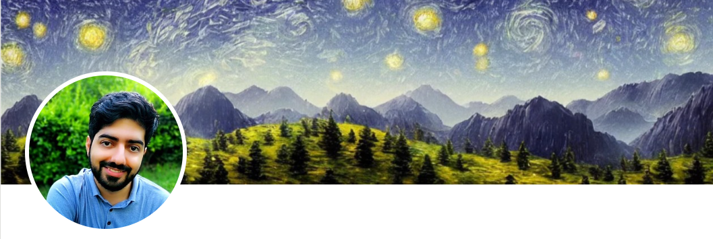
Contact me
Gmail: ImanKhaniJazani@gmail.com
LinkedIn: https://www.linkedin.com/in/ImanKhaniJazani/
Telegram: @IKJ1992

Slide 6
Review

Slide 7
Let’s go to each slides!

Slide 8
About Final Project

Slide 9
Steps to Done!
Team building
Hard skill
Soft skill
Searching and finding a great question!
Team-working for proposal writing
1-3 pages document
Problem definition and suggestion for real solution
Operational plan (time and responsibilities)
Proposal Evaluation!
Team-working for coding and development
Git and Github for code sharing
Discord for team management
Technical Evaluation!
Your score

Slide 10
Ask Your Questions!

